Slide 1
Infographics- ASICS 2016

Slide 2
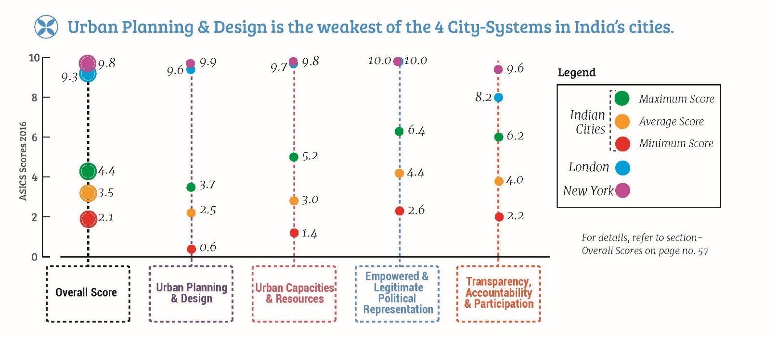
Page reference to the report: Key Insights, Page 1

Slide 3
Page reference to the report: Key Insights, Page 1

Slide 4
City-Systems Asymmetry in large vs small cities: Cities with stronger and more sustainable finances have relatively weak mayors and levels of devolution
Page reference to the report: Key Insights, Page 1

Slide 5
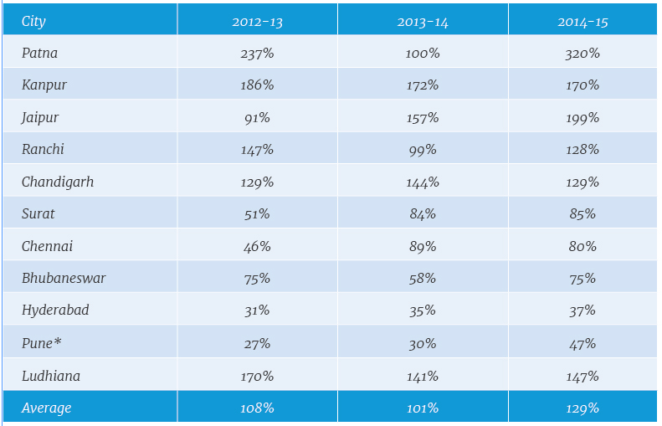
Many Cities do not generate enough own revenue to even cover staff salaries
Page reference to the report: Key Insights, Page 2

Slide 6
Smaller cities, which will be at the forefront of future urbanization, invest significantly less in services and infrastructure that can give their citizens better quality of life.
Page reference to the report: Key Insights, Page 2

Slide 7
Top 10 Cities 2016
Page reference to the report: Executive Summary, Page 6

Slide 8
Estimates for How ‘Urban’ India is, differ vastly
Page reference to the report: Size of India’s Urban Challenge: An Unknown, Page 9

Slide 9
States in India have varying definitions for statutory towns
Page reference to the report: : Size of India’s Urban Challenge: An Unknown, Page 9

Slide 10
Page reference to the report: The Challenge of poor service delivery in urban India, Page 10

Slide 11
Urban Planning and Design: Overall Rank
Page reference to the report: Urban Planning and Design, Overall Rank, Page 14

Slide 12
Timeline: Enactment of Town and Country Planning Acts
Page reference to the report: Is India trying to build 21st century cities with outdated Planning laws?, Page 16

Slide 13
Number of Planners in India compared with other countries.
Page reference to the report: And, do we have enough people to build these cities?, Page 16

Slide 14
Urban Capacities and Resources: Overall Rank
Page reference to the report: Urban Capacities and Resources, Overall Rank, Page 18

Slide 15
How robust are our city budget estimates?
Page reference to the report: Asking the right questions, Page 20

Slide 16
Are we ignoring small cities?
Page reference to the report: Asking the right questions, Page 20

Slide 17
Are our cities sustainable and independent economic units?
Page reference to the report: Asking the right questions, Page 21

Slide 18
Empowered and Legitimate Political Representation: Overall Rank
Page reference to the report: Empowered and Legitimate Political Representation, Page 24

Slide 19
Even 25 Years after the passing of the 74th CAA, devolution remains an unfinished agenda.
Page reference to the report: Interesting Nuggets, Page 26

Slide 20
All cities see a lower voter turnout in Municipal elections.
Page reference to the report: Interesting Nuggets, Page 27

Slide 21
Proportion of women in Municipal Council
Page reference to the report: Gender representation in City Leadership, Page 27

Slide 22
How empowered are our cities and their leaders?
Page reference to the report: Asking the right Questions, Page 28

Slide 23
Transparency, Accountability and Participation: Overall Rank
Page reference to the report: Transparency, Accountability and Participation, Page 30

Slide 24
Page reference to the report: Geographical Distribution of Cities, Page 37

